Slide 1
GEO TRENDS AND TRANSFORMATION MILESTONE-2
JOTHEESWARAN S
DA& DS – FEB’25
DATE:26/05/2025

Slide 2
INTRODUCTION
This project focuses on understanding global trends in population, GDP, health, and literacy from 1960 to 2017.
Using Power BI, we built an interactive dashboard to help visualize and interpret data from multiple sources.
The goal was to derive meaningful insights that could support policy-making and strategic decisions globally.

Slide 3
DATA SOURCES
SQL Database (CountriesWorld): Includes population, GDP per capita, literacy rate,
and health indicators.
Excel Files:
PopulationPerCountry: Year-wise population data.
GDP by Country (1960–2016): Economic performance over time.
MetaData: Income group classification, regions, and special notes.
These sources allowed for a rich and diverse analysis across countries and decades.

Slide 4
DATA PREPARATION
Using Power Query Editor in Power BI:
Cleaned inconsistencies in country names and handled missing/null values.
Merged GDP files into a single structured dataset for time-series analysis.
Removed outliers using median filtering and ensured relationships between tables were correctly mapped.
Merged GDP and Population files accordingly for year-analysis
Finalized a clean and efficient data model ready for visualization.

Slide 5
DAX CALCULATIONS
We used DAX to create custom calculated columns and measures:
Categorized countries by population size, literacy rate, birth/death rates, and GDP groups.
Grouped years by decades for better trend visualization.
Conducted correlation analysis—showing that countries with high literacy tend to have higher GDP per capita. These formulas enhanced interactivity and allowed for deeper insights in our dashboard.

Slide 6
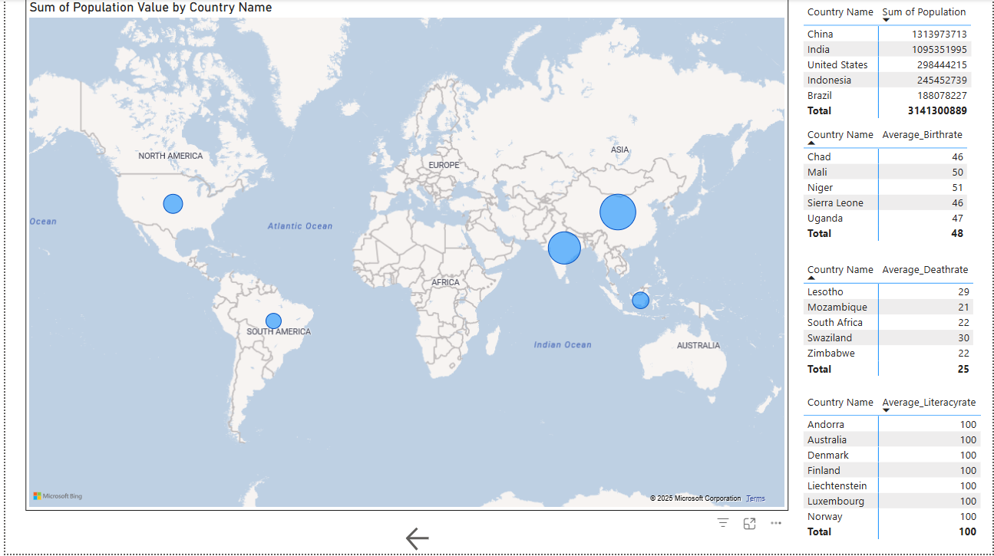
POWER BI VISUALIZATIONS

Slide 7
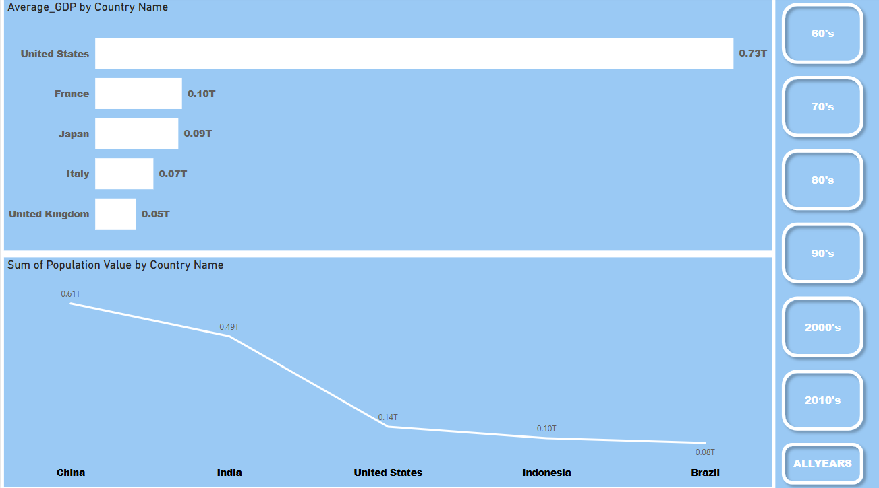

Slide 8
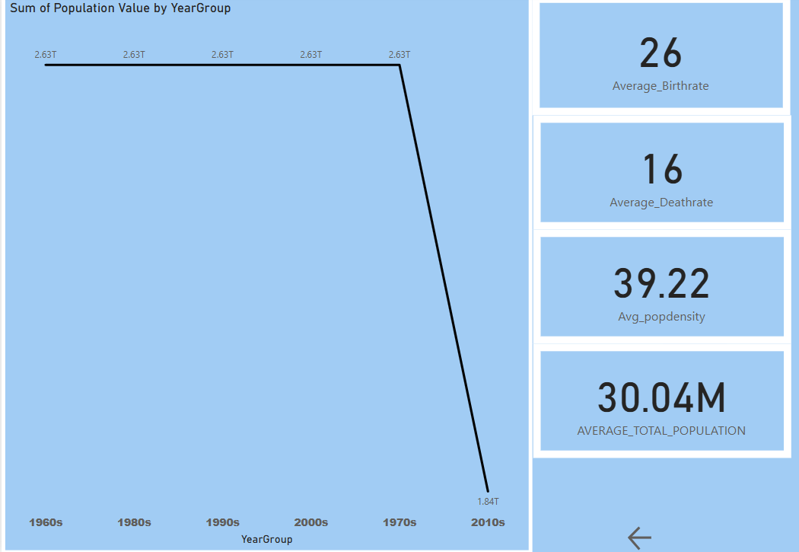

Slide 9
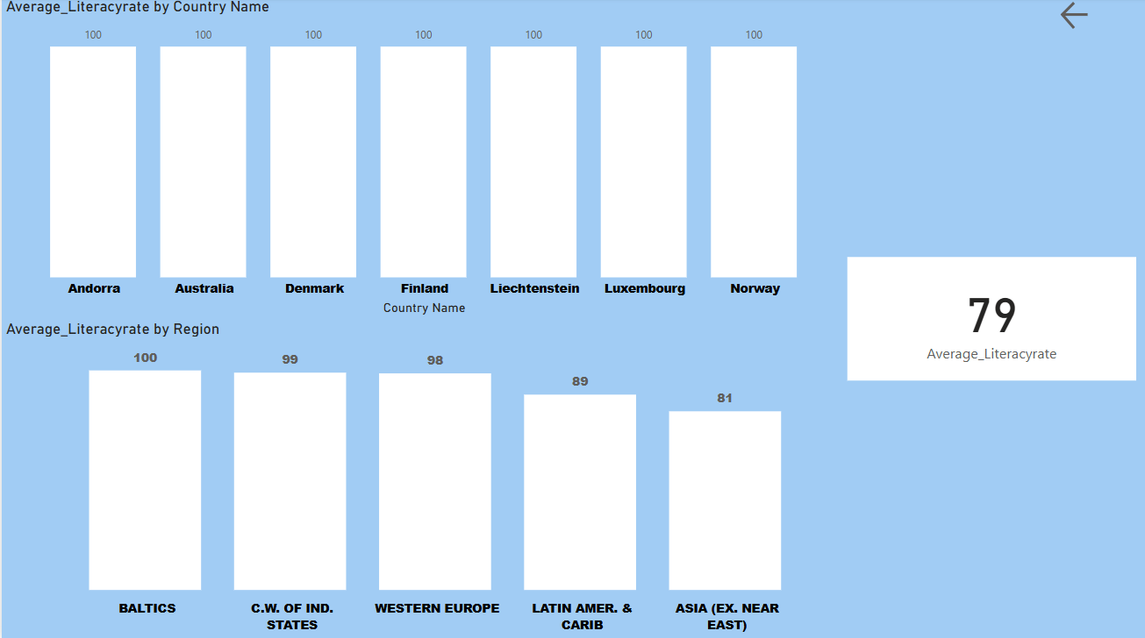

Slide 10
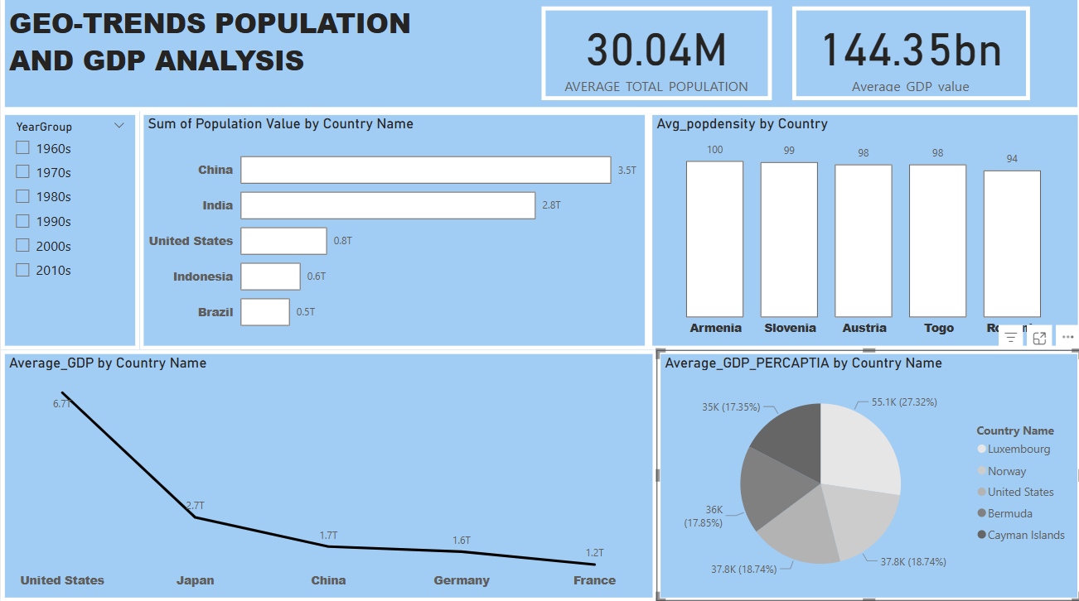
DASHBOARDS

Slide 11
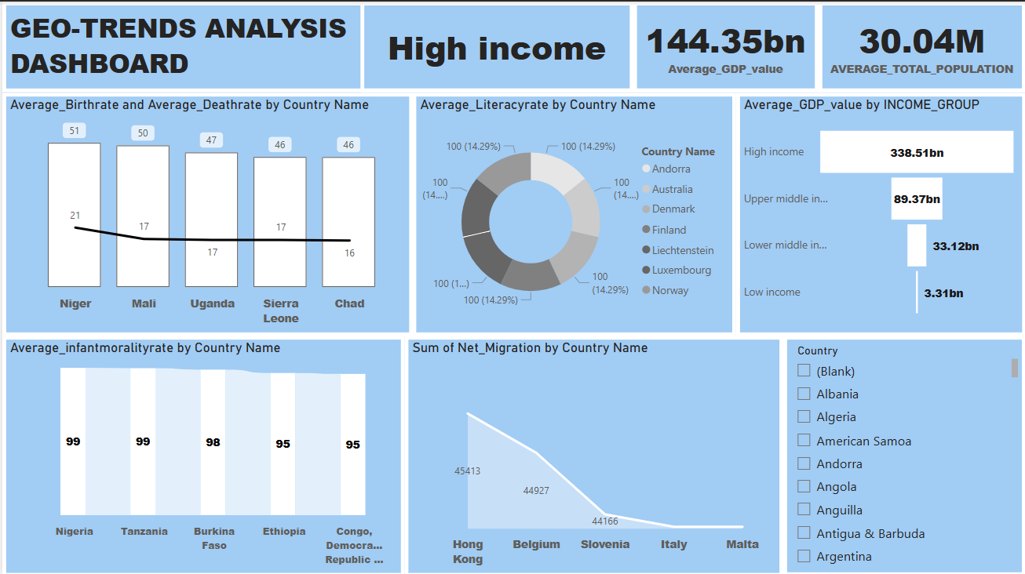

Slide 12
KEY INSIGHTS
1. Population Patterns:
Asia accounts for the largest share of the global population, with China and India together contributing more than one-third.
Rapid population growth is observed in developing countries, especially in Africa and parts of Asia.
2. GDP and Economic Growth:
The United States consistently leads in total GDP across all decades.
Smaller nations like Luxembourg and Norway top the GDP per capita list, indicating high individual prosperity despite lower populations.
High-income countries collectively contribute over 70% of global GDP.

Slide 13
3. Literacy Rates:
100% literacy achieved in several European countries, reflecting strong education systems.
A significant gap remains in literacy rates between high- and low-income nations.
Literacy strongly correlates with GDP per capita, affirming education as a driver of economic development.
4. Health and Mortality Trends:
Infant mortality is disproportionately high in low-income African countries, highlighting healthcare disparities.
Death rates are higher in nations with weak health infrastructure or conflict zones.
5. Birth & Death Rates:
High birthrate countries also tend to have high infant mortality, indicating poor access to maternal and child healthcare.
Developed countries show lower birthrates and deathrates, indicative of advanced healthcare and aging populations.
6. Regional Disparities:
Western Europe and North America dominate in both economic output and social indicators.
Sub-Saharan Africa continues to face development challenges in health, education, and economy.
Migration patterns point toward developed countries as hubs of economic opportunity.

Slide 14
CONCLUSION
Education and economy are strongly linked—higher literacy often means higher GDP.
Inequality remains a challenge, especially for low-income countries.
Population data guides future planning—infrastructure, health, and education must align with trends.
Power BI made complex data easy to analyze through interactive visuals.
Key focus for global development should be education, healthcare, and balanced economic investment.
Data-driven strategies are essential for impactful decision-making.

